Slide 1
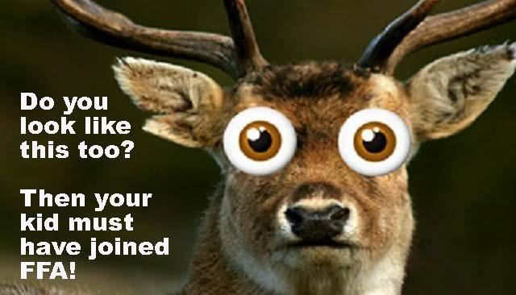
Lake Travis FFA Alumni
Parent 101
August 30, 2022

Slide 2
Frequently Asked Questions
What is FFA?
What does FFA look like?
Who’s invited to participate?
Why would you want to participate?
What do the students in FFA do?
What do the FFA Alumni (parent members) do?
How much will it cost?
Where does the money go?
How much does raising an animal cost?
Where do we learn more?

Slide 3
What is FFA?
“We’re growing the next generation of leaders who will change the world.”
FFA is the premier youth organization preparing members for leadership and careers in the science, business and technology of agriculture.
Founded in 1928; national organization in all 50 states, Puerto Rico, & the Virgin Islands; 156,000 + student members across Texas

Slide 4
FFA Creed
Jenna Dow, President

Slide 5
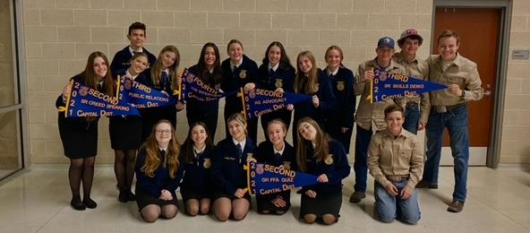
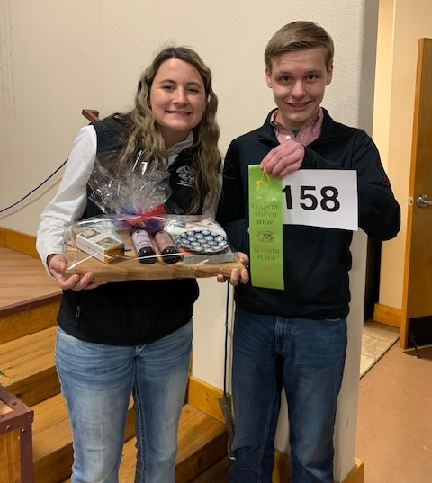
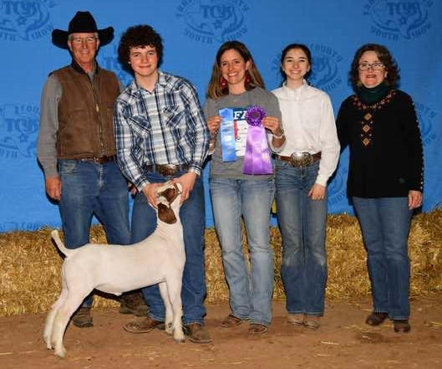
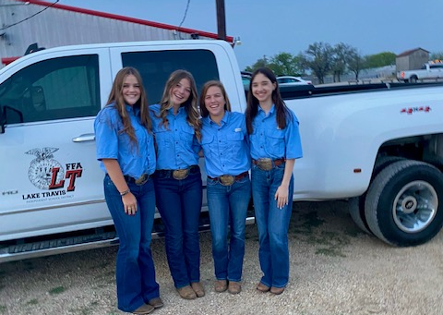
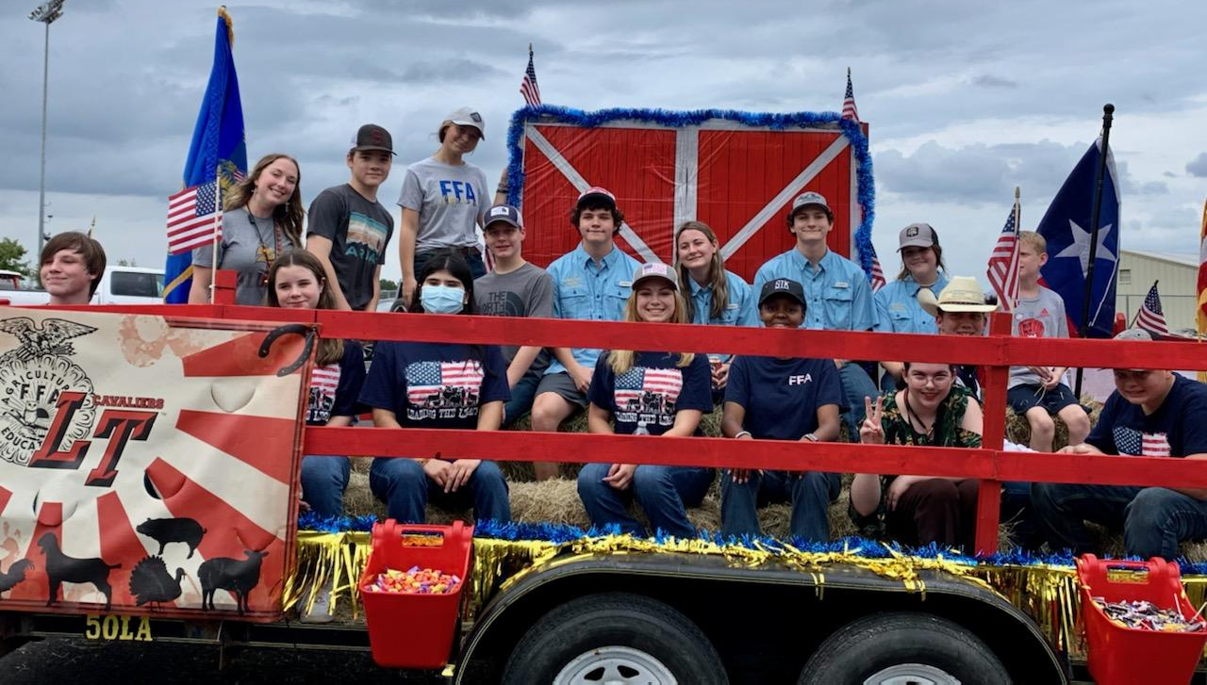

Slide 6
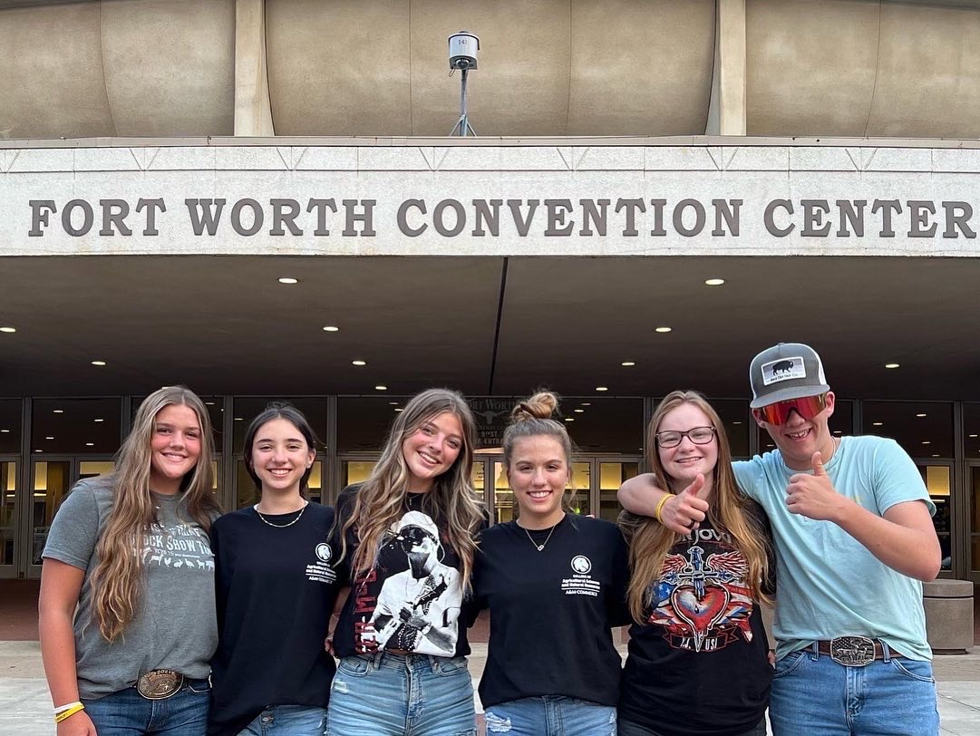
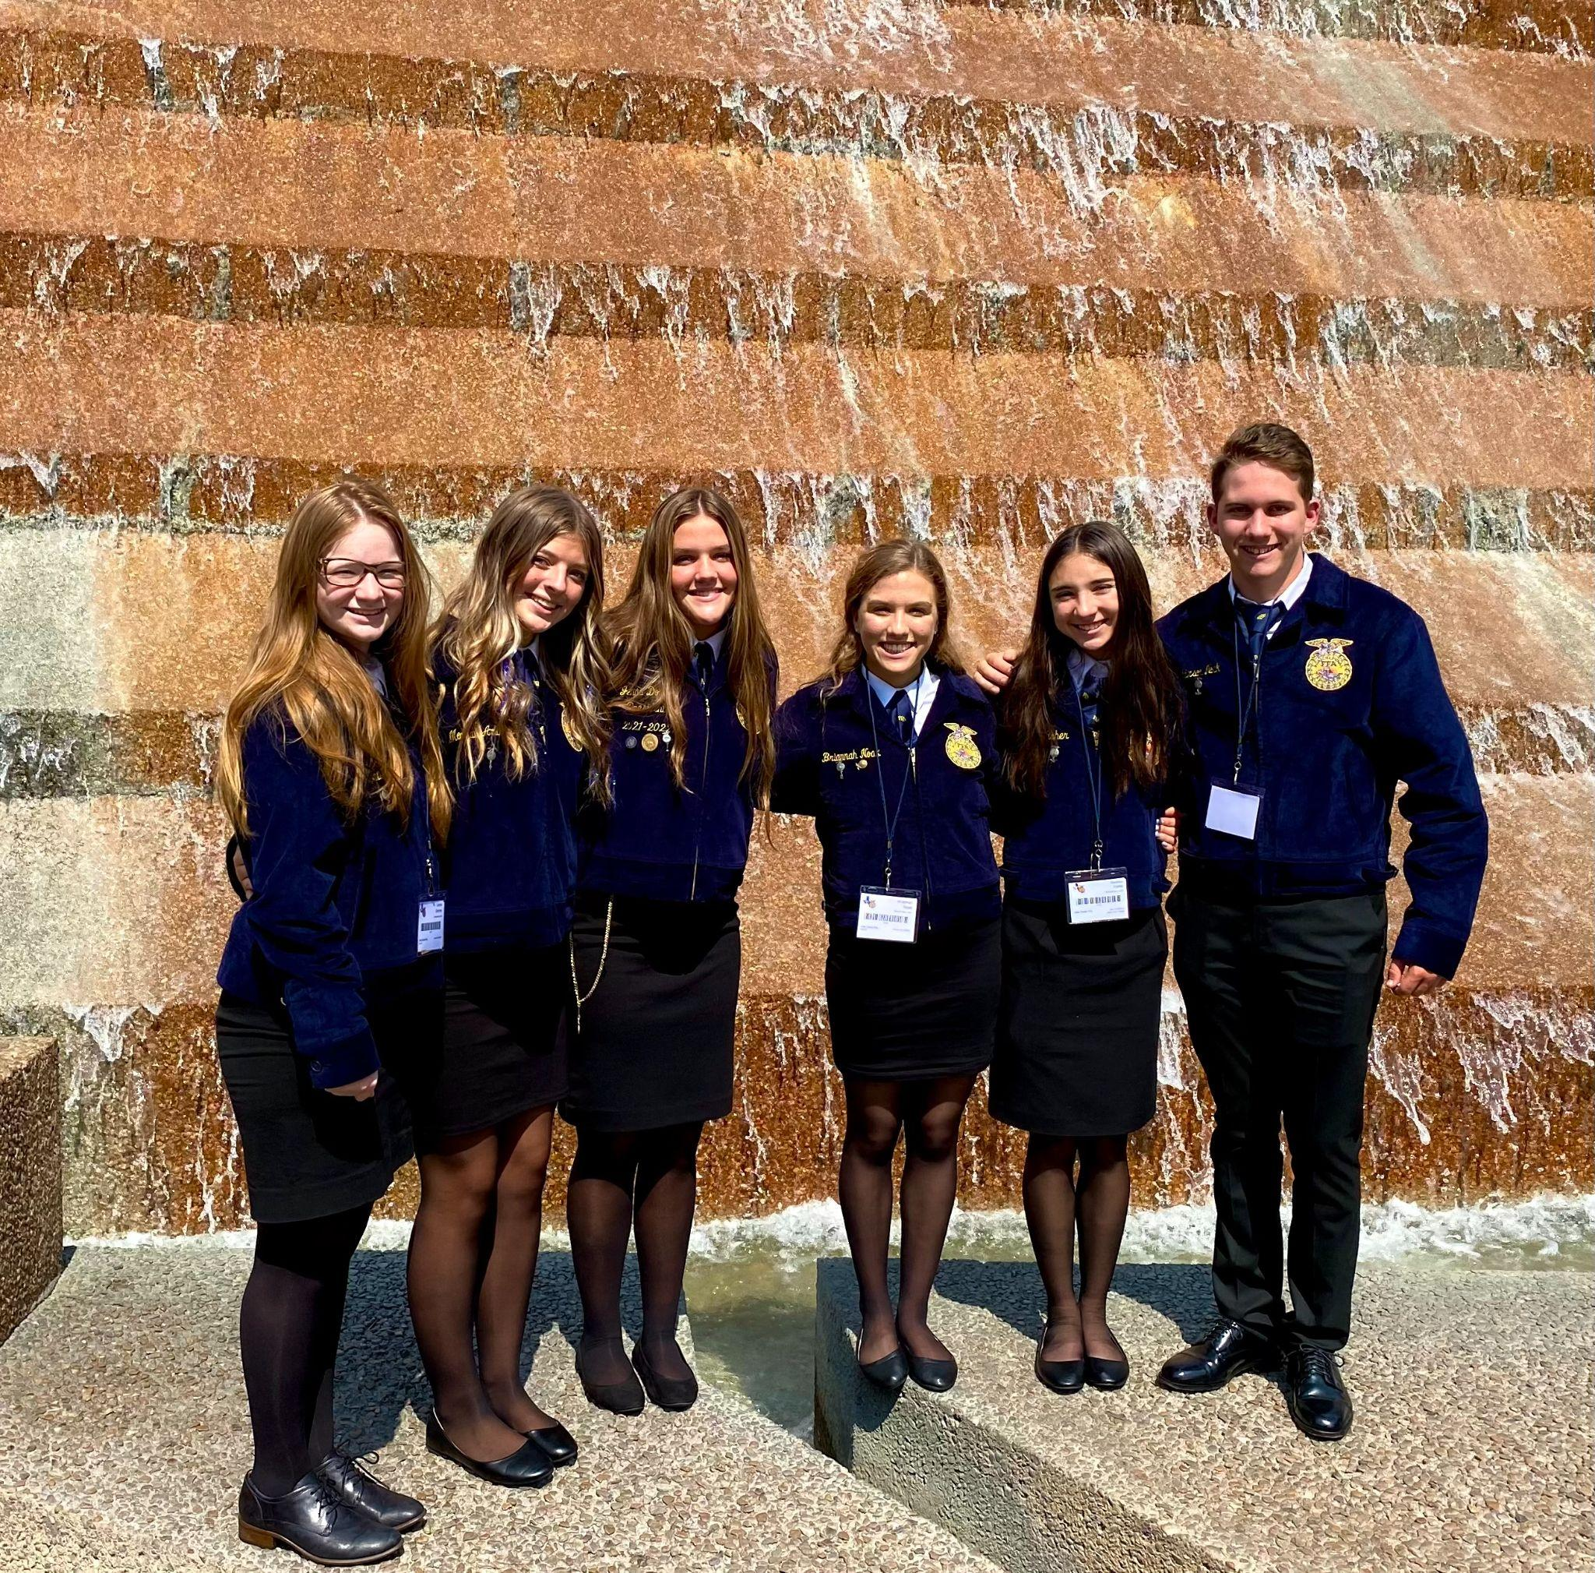
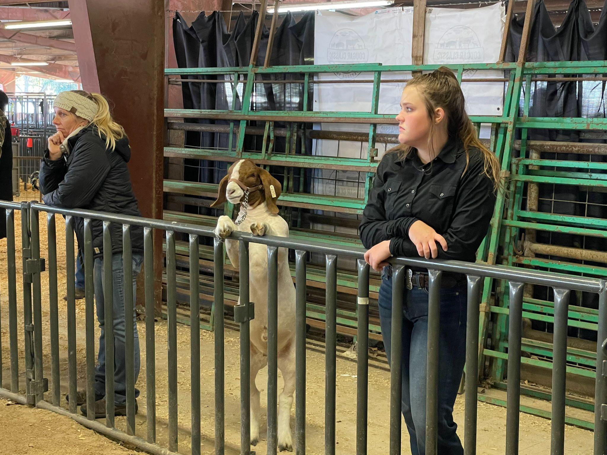
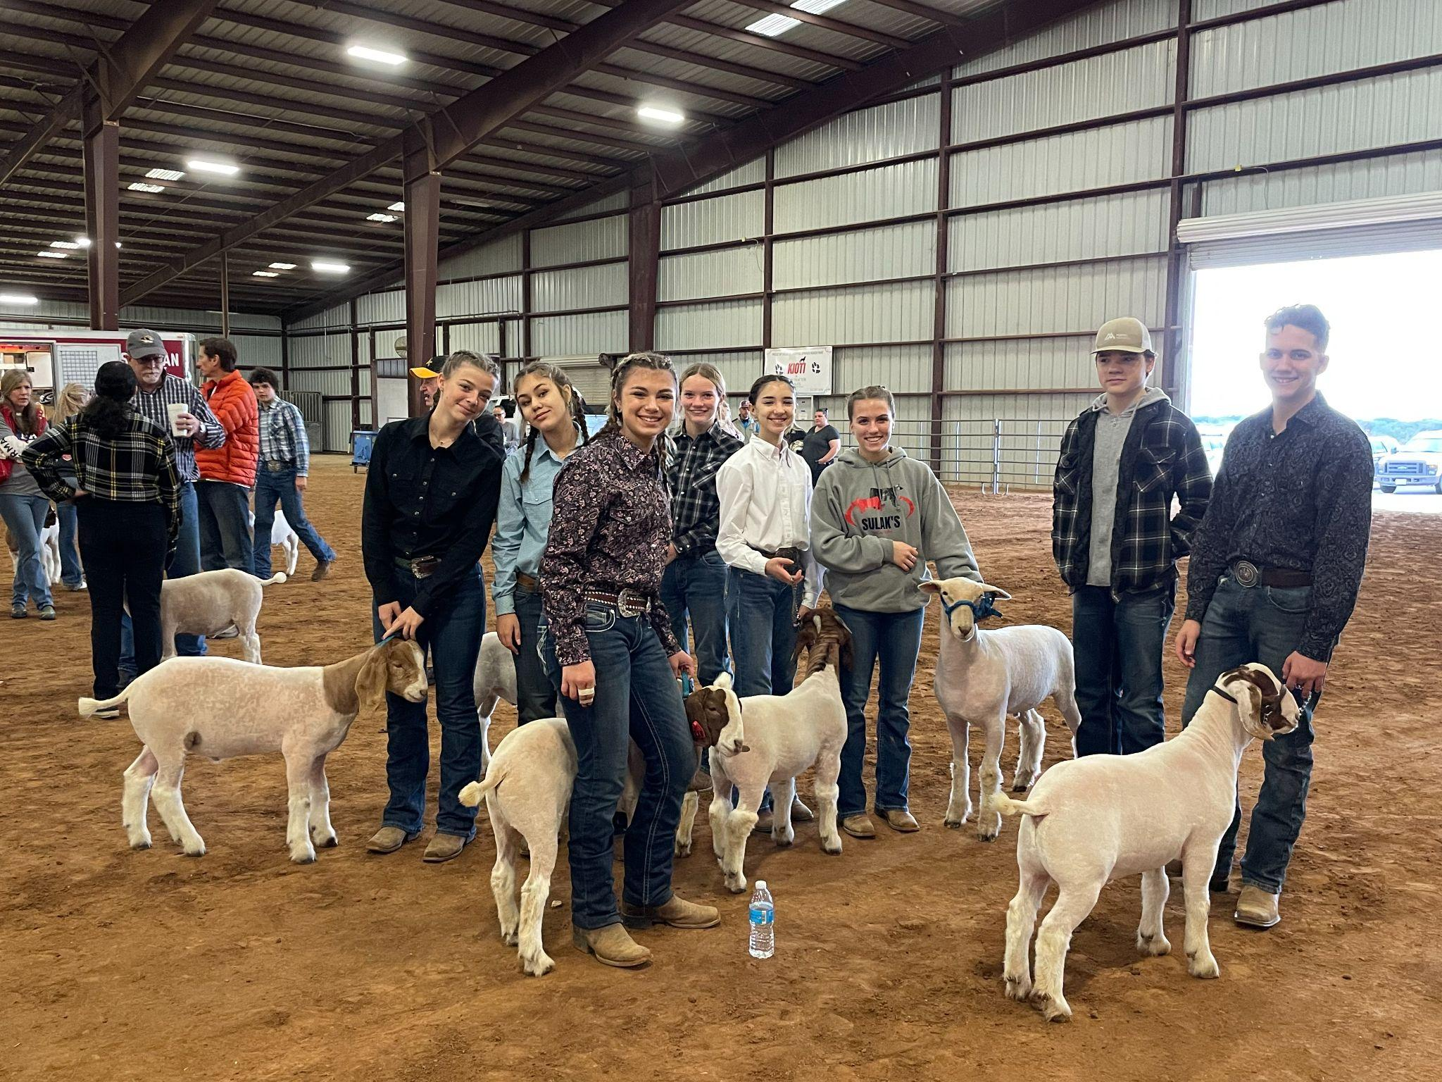
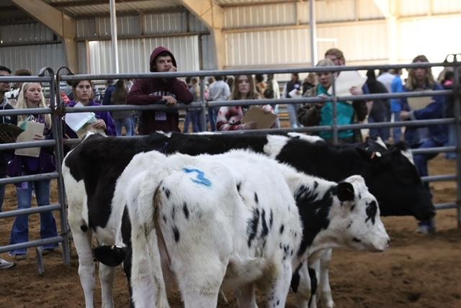
What does FFA look like?
https://fb.watch/fc_625XR5z/
State FFA Convention

Slide 7
Who’s Invited to Participate?
Students who take ag classes (must be in one ag class/per year) in high school.
Any other students in the district 3rd- 8th grade who want to raise animals as part of the program
Parents!

Slide 8
Why would you want to participate?
Kids learn immeasurable leadership and responsibility.
Lifelong skills in animal husbandry.
Exploration of skills like welding, veterinary medicine, and other ag-related industries.
Presentation skills.
District, area, state, national competitions and convention
Small group = strong camaraderie
Parents get to work alongside children for just a few more years!

Slide 9
What do the students do?
Supervised Animal Experience -- Raising goats, lambs, steers, pigs, chickens, turkeys or rabbits for market shows; can earn monetary awards – NO PRIOR EXPERIENCE NECESSARY!
County youth fair (TCYS -- baking to photography)
LDEs and CDEs (spring and fall competitions from public speaking to animal judging)
Volunteer at Events – pet shot clinics, Cavalier Classic
Monthly meetings/social events
Officers attend annual convention with 15,000 other members across state of Texas

Slide 10
What does the Alumni do?
Support kids:
Help in the barn if raising animals
Volunteer at events (i.e., Cav Classic, Pet Shot clinic)
Support kids in school events (snacks for competitions, homecoming float, etc.)
Participate in fundraising; secure donations/contribution = $500/family
Come to monthly meetings
Join Remind groups, facebook pages to get regular group communication

Slide 11
How Much Will it Cost?
Member Expenses: - Membership Dues (t-shirt included)
Students= $30 for High School $20 for 3rd-8th
Parents/Alumni = $40 single $60 both parents
- Family donations/contribution $500/family
- Official Dress for competitions (approx. $100-150)

Slide 12
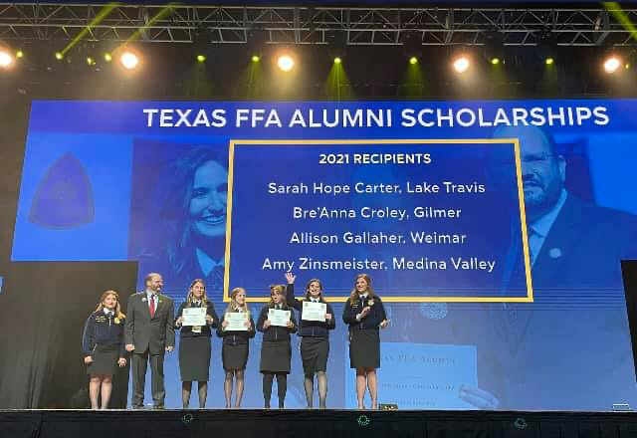
Where Does the Money Go?
Support club activities throughout the year (travel to competitions, t-shirts, etc., state convention attendance)
Money given directly back to kids who make sale at TCYS (scholarship money)
Facility Improvements/Barn supplies
Scholarships to our seniors

Slide 13
How Much Does Raising an Animal Cost?
Pigs $500 +
Goats $500 +
Lambs $500 +
Steers $2500 +
Feed/Tack (buckets, halters, etc.)
Show Entries
Pen Deposits/Rentals Deposit- $100
Rent - small animal $50
steer $100
THE EXPERIENCE - PRICELE$$

Slide 14
Common Concerns with Raising Animals...
Where do the animals live?
Where do they go after show season?
Do they have to be fed every day?
What if I want to go out of town?
How much do they cost?
What about veterinary care?

Slide 15
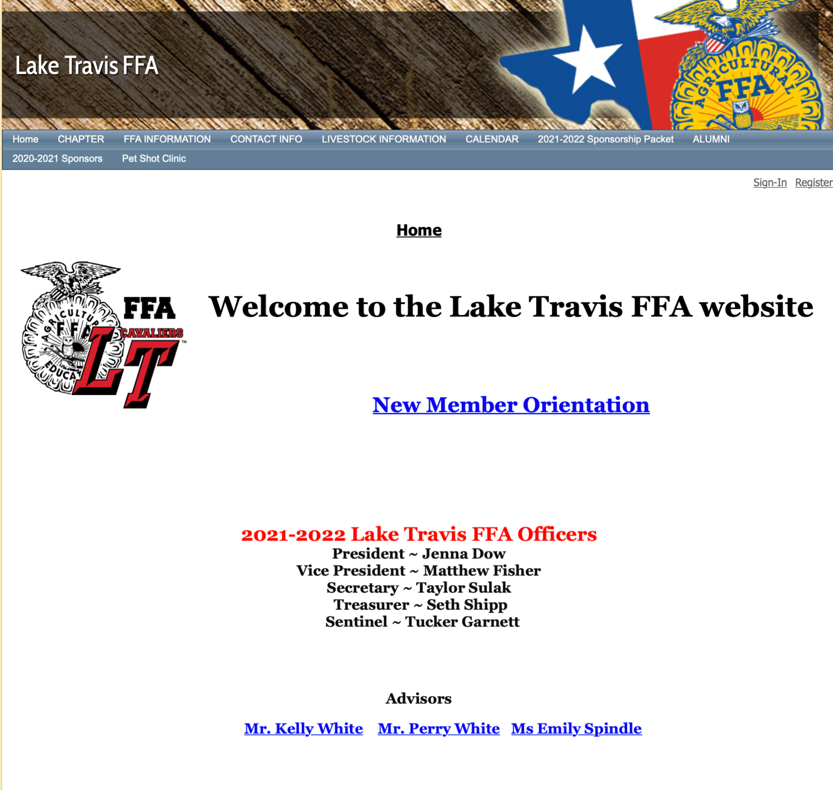
Where do we learn more?
http://www.laketravisffa.ffanow.org

Slide 16
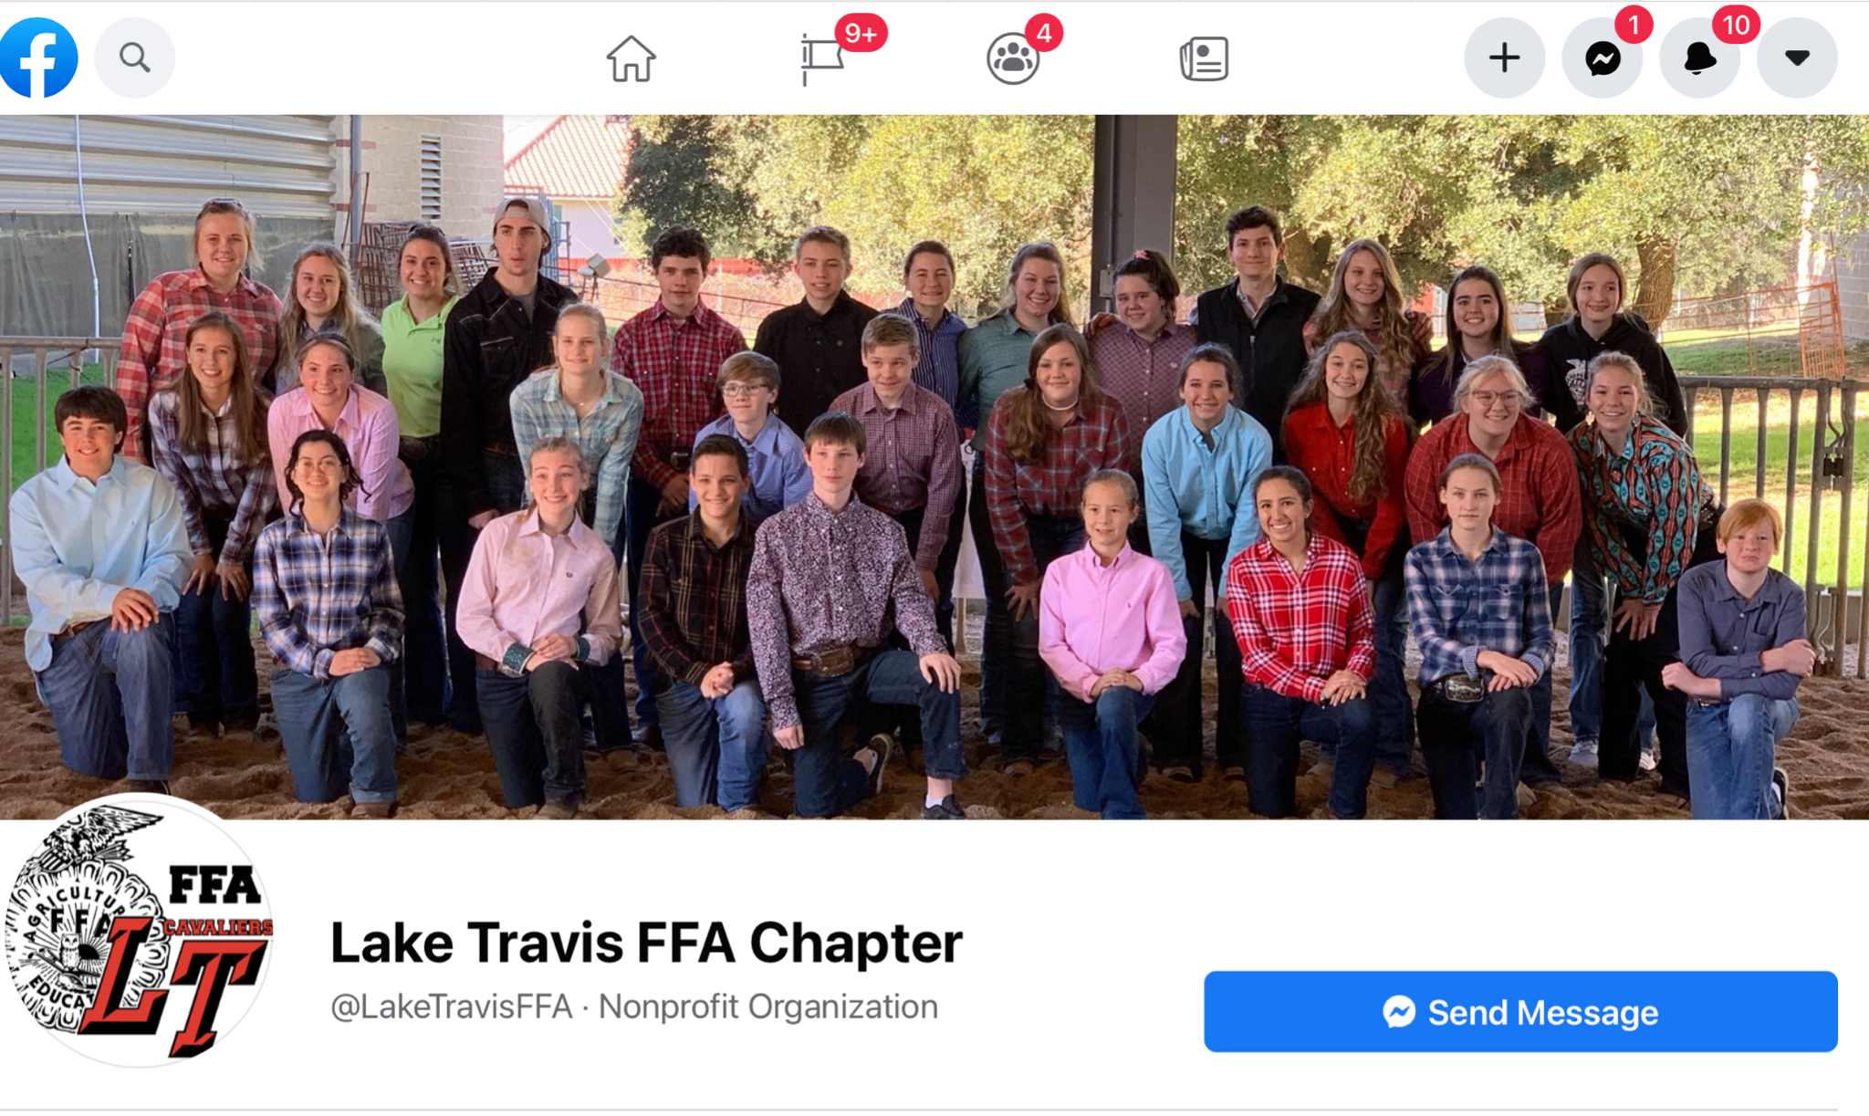
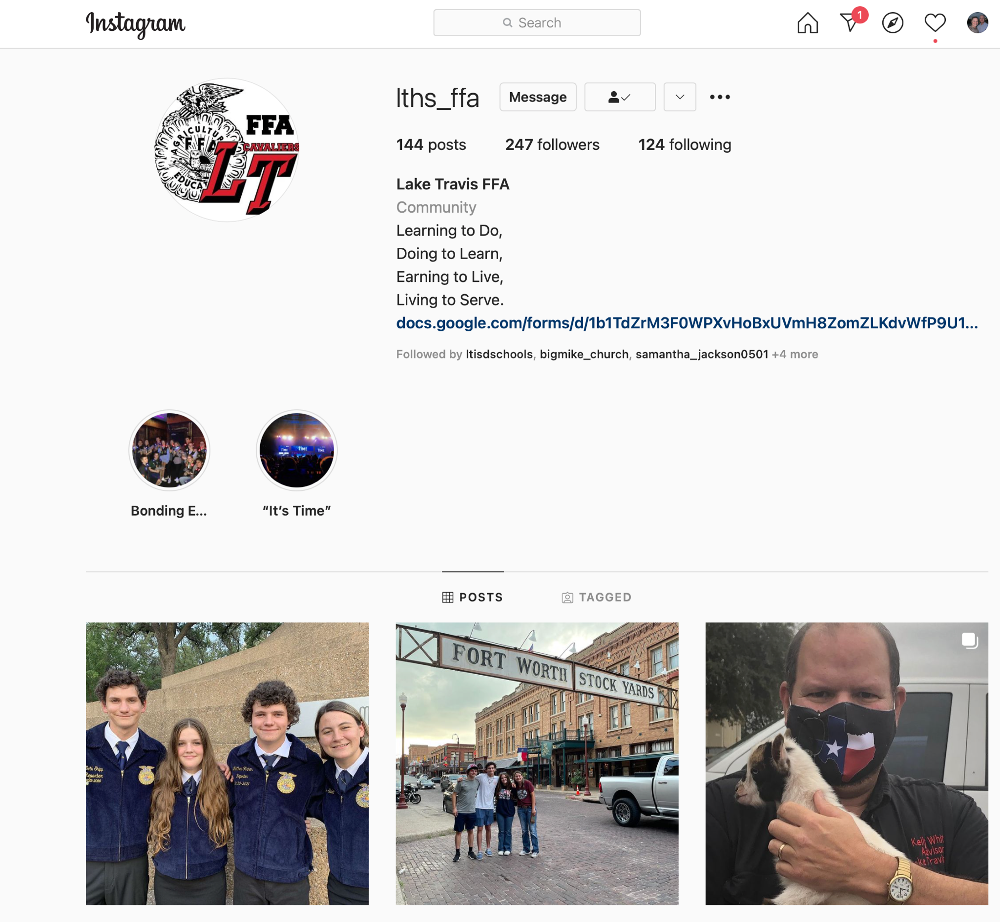
FFA Social Media Pages
facebook.com/LakeTravisFFA
instagram.com/lths_ffa/
You Tube Videos

Slide 17
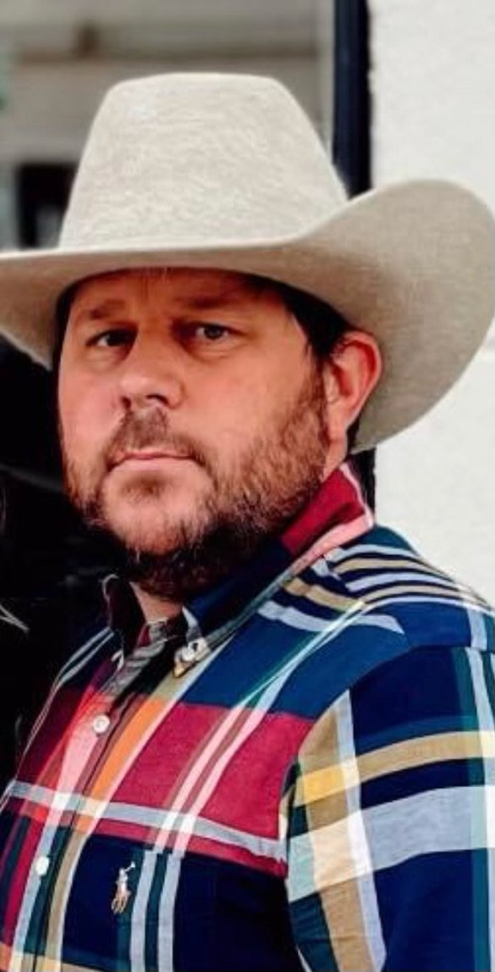
Faculty Advisors
Who Do I See For More Information?
K. White kwhite@ltisdschools.org
P. White
pwhite@ltisdschools.org
Mr. Fleming flemingj@ltisdschools.org

Slide 18
Meeting Adjourned
First Alumni Meeting
Tuesday, September 13
Cafeteria
6 PM
Thank you for attending

